Slide 1
Photochemistry

Slide 2
Content
Dark and Photochemical reaction
Laws of photochemistry, Quantum efficiency
Primary and secondary photochemical processes
Consequences of light absorption
Chemiluminescence, Fluorescence, Phosphorescence
Photosensitization, Photochemical equilibrium
Photochemical and Photophysical processes
Mechanism and kinetics of photochemical reactions
Photochemical chain and non-chain reactions
Photolysis of acetaldehyde
Lasers and its applications in chemistry

Slide 3
Photochemistry
Photochemistry is that branch of science which deals with the chemical processes that occur when a material is illuminated by radiation from an external source
Photochemistry is the branch of chemistry concerned with the chemical effects of light. It is the study of the interaction of electromagnetic radiation with matter resulting into a physical change or into a chemical change.
So, photochemistry is the science of the chemical effects of radiation whose wavelength lie in the visible and ultraviolet region, i.e., in the wavelength range from 200 nm to 800 nm.

Slide 4
Types of Chemical Reactions
A chemical reaction is one in which, the identity of molecules is changed due to the rupture and formation of chemical bonds. Chemical reactions are two types, these are:
1) Dark or thermal reactions
2) Photochemical reactions
1) Dark or thermal reactions:
Ordinary reactions occur by absorption of heat energy from outside.
The reacting molecules are energised and molecular collisions become effective. These bring about the reaction.

Slide 5
Dark or Thermal Reactions
The reactions which are caused by heat and in absence of light are called dark or thermal reactions.
These are the ordinary chemical reactions which are influenced or induced by temperature, concentration of reactants, presence of catalyst, etc. except light radiations. For examples:
N₂ + 3H₂ = 2NH₃
H₂ + I₂ = 2HI
PCl₅ = PCl₃ + Cl₂

Slide 6
Types of Chemical Reactions
2) Photochemical reactions:
A photochemical reaction may be defined as any reaction which is induced or influenced by the action of light on the system.
The reactant molecules absorbs photons of light and get excited. These excited molecules then produce the reactions.
All spontaneous reactions are accompanied by a decrease of free energy, but photochemical reactions takes place with increase of free energy, as a result of free energy supplied by light.
H₂ + Cl₂ → 2HCl
6CO₂ + 6H₂O → C₆H₁₂O₆ + 6O₂

Slide 7
Photochemical reactions
A mixture of hydrogen and chlorine remains unchanged with lapse of time. But when exposed to light, the reaction occurs with a loud explosion.
H₂ + Cl₂ → 2HCl
6CO₂ + 6H₂O → C₆H₁₂O₆ + 6O₂
hν
hν

Slide 8
Difference between photochemical and thermal reactions
Photochemical Reaction | Thermal Reaction
These reactions involve absorption of light radiations. | These reactions involve absorption or evolution of heat.
Presence of light is the primary requirement. | These reactions can take place in light as well as in dark.
Rate of reaction is independent on temperature. | Rate of reaction depends on temperature.
ΔG may be +ve or –ve. | ΔG is always –ve.
Photochemical activation is highly selective process. | Thermal activation is not selective in nature
Energy varies from 23 to 230 kcal/mol. | Energy needed in the range of 100 to 1000 kcal/mol.

Slide 9
Laws of Photochemistry
1) Grotthuss-Draper law
This law states that
“ Only those radiation which are absorbed by a reacting substance or system are responsible for producing chemical change.”
According to this law, all light radiations are not bringing the chemical reaction. Some are increase the kinetic energy of molecule while some are re-emitted (i.e. fluorescence).

Slide 10
2) Eienstien law of photochemical equivalence
The law of photochemical equivalence states that
“When an atom or molecule absorbs light of a given frequency, it absorbs one quantum only.”
This law also states that (Stark and Einstein)
“Each molecule which takes part in a chemical reaction absorb one quantum of light which induces the reaction.”
Explanation
A molecule acquire energy by absorbing photon as,
A + hν = A*
The energy of one photon is equal to hν, where ν is the frequency of absorbing photon and h is the plank’s constant.

Slide 11
Eienstien law of photochemical equivalence
For activation of one mole ,
E = Nhν
where N is the Avogadro’s number and is equal to one mole.
This quantity of energy E absorbed per mole of the substance is called an Einstein. But N = 6.023x10²³ molecules, h = 6.624x10⁻²⁷ erg sec. Therefore,
E = 6.023x10²³x 6.624x10⁻²⁷xν ergs
= 6.023x10²³x 6.624x10⁻²⁷xν/4.186x10⁷ calories
= 9.53x10⁻¹¹xν calories
= 9.53x10⁻¹¹x3x10¹⁰/λ calories
where ν = c/λ = 3x10¹⁰/λ

Slide 12
Primary and Secondary Processes
Photochemical processes are complete with the formation of photochemical products via deactivating the excited state.
Bodenstein pointed out that the photochemical reaction involve in two distinct processes, namely primary and secondary processes.
Primary photochemical processes
Process in which light radiation is absorbed by an atom or molecule giving rise to the formation of an excited atom or an excited molecule.
A + hν A*

Slide 13
Primary and Secondary Processes
Secondary photochemical processes
Processes which involves the excited atoms, molecules or free radicals produced in the primary process.
Consequence of light absorption can be discussed under the following two headings:
a) Light absorptin by atoms
b) Light absorption by moloecules

Slide 14
Consequences of light absorption
The consequence of molecules absorbing light is the creation of transient excited states whose chemical and physical properties differ greatly from the original molecules.
These new chemical species can fall apart, change to new structures, combine with each other or other molecules, or transfer electrons, or their electronic excitation energy to other molecules.

Slide 15
Consequences of light absorption
When ultraviolet or visible light is absorbed by an atom or molecule, an electron is excited.
In other words, it is raised to an orbital of higher energy than the one it usually occupies.
There are several options that could happen next after absorption of photon, either the electron returns to the ground state emitting the photon of light or the energy is retained by the matter and the light is absorbed.

Slide 16
Consequences of light absorption by atom
1) Primary effects of photon absorption by atoms are:
  (a) Electronic excitation: One or more electrons go into higher energy levels.
  (b) Ejection of electrons: If excitaion is high, one or more electrons may given out by an atom; causes ionization. Average lifetime of electronically excited atom is 10⁻⁷ to 10⁻⁸ s. Secondary effects follow the primary effects.

Slide 17
Consequences of light absorption by atom
  2) Secondary effects of photon absorption by atoms are:
  Fluorescence: Excited electron returns to ground state or lower enegy levels instantaneously, emitting a part or whole of excitation energy.
  Resonance fluorescence: Excited electron return to ground state emitting radiation of exactly same frequency of incident radiation.

Slide 18
Consequences of light absorption by atom
  (c) Phosphorescence: Fluorescence stops immediatly after the incident light is cut off. In some cases the emission of radiation persist for some time after the incident light is cut off, this phenomenon is known as phosphorescence.
  (d) Photochemical reaction: Excited atoms may take part in chemical reactions with non-excited atoms or molecules.
  (e) Photosensitization: An excited atoms may collide with a molecule and by energy exchanges may cause the molecules to dissociate.

Slide 19
Consequences of light absorption by atom
The above cases of energy transfer can be summarised as follows:
  (a) Primary excitation by photon absorption,
A + hν A* (Excited atom)
  (b) The excited atom may activate another atom with which it collides,
A* + B A + B* (Excited atom)
  (c) The excited atom may collide with a molecule and activate it,
A* + B₂ A + B₂*
  (d) The excited atom may react with the colliding molecule A* + B₂ AB + B (Reaction)
  (e) The excited atom may collide with a molecule which in turn dissociate
A* + B₂ A + 2B (Photosensitization)

Slide 20
Consequences of Light Absorption by Molecules
A majority of systems consists of molecules than atoms.
  1) Primary effects: The absorption of light may produce the following primary effects:
  (a) Excitation of molecules: includes electronic, vibrational and rotational excitation.
  (b) Isomeric change to form new molecules: direct photochemical effects.
  (c) Dissociation of molecules: direct photochemical change.
  (d) Ionisation of molecules through electron ejection: known as photoionisation.

Slide 21
Consequences of Light Absorption by Molecules
  2) Secondary effects: If the dissociation or ionisation of absorbing molecules does not occur by direct absorption of radiation, then the energy of excited molecules can give rise to the following secondary effects:
  (a) Photosensitization reactions
  (b) Delayed photochemical changes
  (c) Rise in temperature
  (d) Fluorescence
  (e) Phosphorescence

Slide 22
Primary photochemical process and molecular spectrum
Photochemical reaction requires absorption of energy as the first step,
the result is that the reacting molecule is raised to a higher energy level.
For photochemical reaction an electronic transition occurs in the visible or ultraviolet region.
The nature of the resulting primary process the depends on the relationship between the upper and lower electronic states of the molecule.

Slide 23
Primary photochemical process and molecular spectrum
Four types of behavior are of interest in connection with the primary photochemical process which are depicted in figure.
Type I:
In type I, the nature of the potential energy curves is such that in the transition indicated the vibrational energy of the molecule in the upper electronic state exceeds the maximum value.
After absorption of energy the molecule will dissociate in its 1st oscillation.
Transition from lower vibrational levels in the lower electronic state will not be accompanied by dissociation.

Slide 24
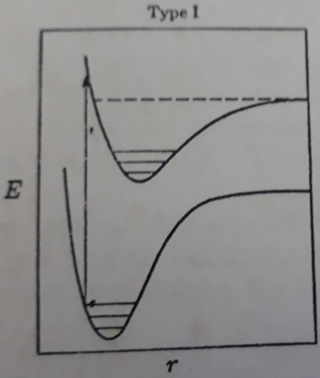
Primary photochemical process and molecular spectrum
The absorption of light in the continuous region of the spectrum results in dissociation of the molecule is the primary photochemical process.
In the region of discrete or banded structure, dissociation will not occur.
The molecule will be in an electronically excited state.

Slide 25
Primary photochemical process and molecular spectrum
Type II:
In type II, no transition from lower to upper state can result in dissociation of the molecule.
The electronic spectrum consists of a series of bands with no continuous region.
Absorption of energy can result only in the formation of an excited molecule.
The primary photochemical process is then excitation of the absorbing molecule, just as in the banded region in case I.

Slide 26
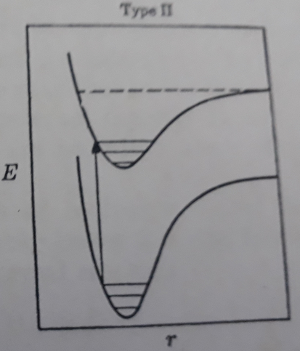
Primary photochemical process and molecular spectrum

Slide 27
Primary photochemical process and molecular spectrum
Type III:
Type III is uncommon, the upper electronic state is completely unstable and has no vibrational levels.
The molecular spectrum then has no bands, but is continuous throughout.
In these circumstances the electronic transition is always accompanied by dissociation of the molecule.

Slide 28
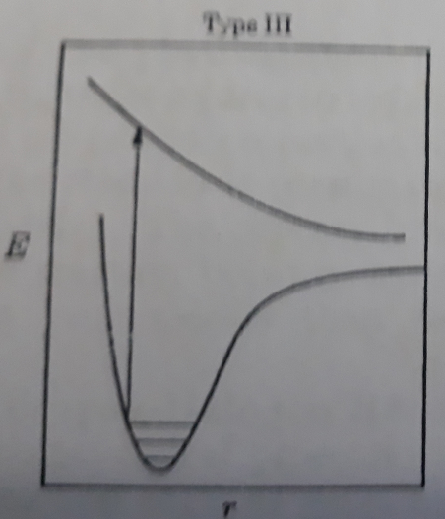
Primary photochemical process and molecular spectrum

Slide 29
Primary photochemical process and molecular spectrum
Type IV:
Type IV is a combination of type II and III.
There are two upper electronic levels close together; one is like that in case II (stable) and other like case III (unstable)
Transition from the lower state occurs to the stable upper state.
During vibration the excited molecule is changed into the unstable state, at the point where the two curves cross one another, the molecule then dissociates.
The behavior of this type is called predissociation.
The electronic spectrum has a banded structure, but in the region of predissociation the rotational line are absent, the vibrational bands having a diffuse appearance.

Slide 30
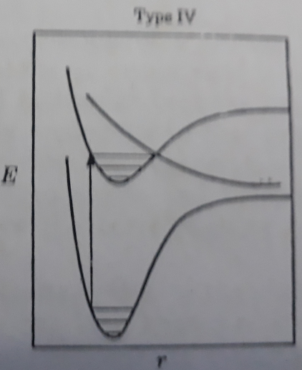
Primary photochemical process and molecular spectrum
The reason for this is that dissociation occurs during a shorter period than is required for the molecule to rotate.
If absorption occurs in the diffuse region of the spectrum, the primary photochemical process is dissociation, in the banded region it is electronic excitation, as in cases I and II.

Slide 31
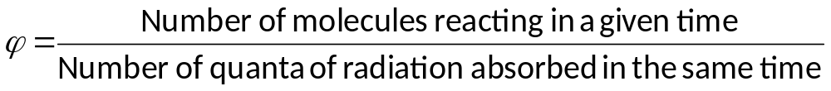
Quantum Efficiency or Quantum Yield
Efficiency of a photochemical process is expressed in terms of quantum efficiency or quantum yield (ϕ). It states that
“the number of molecules reacting per quantum of light absorbed.”
Energy of one photon, E = hν, and 1 mole = N molecules
Since each molecule absorbs one photon.

Slide 32
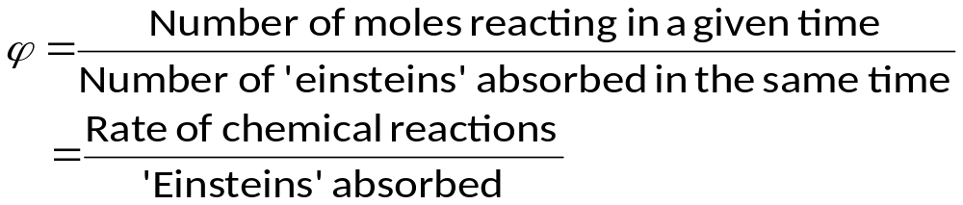
Quantum Efficiency or Quantum Yield
Energy absorbed by N molecules = Energy of N photons
E = Nhν
The energy (E) which activates one mole of reactant, i.e., energy corresponding to N photons is called ‘one einstein’. So,
‘Einsteins’ is the unit of photochemical intensity. The value of φ may vary from 1 to 1010; in some cases it is less than 1.

Slide 33
Quantum Efficiency or Quantum Yield
For a reaction that obeys strictly the Einstein law, one molecule decomposes per photon, the quantum yield, φ = 1.
When two or more molecules are decomposed per photon, φ > 1 and the reaction has a high quantum yield.
High quantum yield reactions
When φ > 1
CO + Cl₂ → COCl₂ φ = 10³
H₂ + Cl₂ → 2HCl φ = 10⁴ to 10⁶
2H₂O₂ → 2H₂O + O₂ φ = 7

Slide 34
Quantum Efficiency or Quantum Yield
If the number of molecules decomposed is less than one per photon, the reaction has a low quantum yield (φ < 1).
  Low quantum yield reactions
  When φ < 1
H₂ + Br₂ → 2HBr φ = 0.01
2NH₃ → N₂ + 3H₂ φ = 0.2
CH₃COCH₃ → CO + C₂H₆ φ = 0.1

Slide 35
Reasons for Low and High Quantum Yield
Reasons for low quantum yield
Excited molecules may get deactivated before they form a product so the value is less than 1.
Collision of excited molecule with non-excited molecule.
Molecules may not receive adequate energy to enable them to react.
The photochemical reaction may be reversed.

Slide 36
Reasons for High Quantum Yield
When one photon decomposes or forms more than one molecule, the quantum yield φ > 1 and is said to be high. The main reasons for high quantum yield are :
One photon absorbed in a primary reaction dissociates one molecule of the reactant. But the excited atoms that result may start a subsequent secondary reaction in which a further molecule is decomposed
AB + hv → A + B Primary
AB + A → A₂ + B Secondary
Obviously, one photon of radiation has decomposed two molecules, one in the primary reaction and one in the secondary reaction. Hence the quantum yield of the overall reaction is 2.

Slide 37
Reasons for High Quantum Yield
When there are two or more reactants, a molecule of one of them absorbs a photon and dissociates (primary reaction). The excited atom that is produced starts a secondary reaction chain.
A₂ + hv → 2A ...(1) Primary
A + B2 → AB + B ..(2) Secondary
B + A₂ → AB + A ...(3) Reaction chain
It is noteworthy that A consumed in (2) is regenerated in (3). This reaction chain continues to form two molecules each time. Thus the number of AB molecules formed in the overall reaction per photon is very large. Or that the quantum yield is extremely high.

Slide 38
Reasons for high quantum yield
The product of primary process may collide with 2nd molecule and transfer energy. 2nd to 3rd and so on. Thus the chain reaction starts and number of reacting molecule will be high. The activated molecule reacts with another molecule.
The radiation absorption includes the production of the atoms with initiate the chain reaction.
Due to the formation of intermediate product which acts as a catalyst.
After the absorption of radiation, the activated molecule which is formed may collide with another active molecule.

Slide 39
Luminescence
When the emission of visible radiation occurs due to some cause other than temperature, the phenomenon is known as luminescence. Luminescence is of the following types:
1) Photoluminescence
2) Chemiluminescence
3) Bioluminescence
4) Cathodoluminescence
5) Electroluminescence

Slide 40
Luminescence
Photoluminescence:
Luminescence caused by light is called photoluminescence.
Photoluminescence that ceases immediately after the cause of excitation is cut off is called fluorescence.
Photoluminescence that persists for an appreciable time after the stimulating process is cut off is called phosphorescence.

Slide 41
Luminescence
Chemiluminescence:
Luminescence resulting from chemical reactions is called chemiluminescence.
Bioluminescence:
Observed on living organism
Cathodoluminescence:
Luminescence caused by bombardment of electrons is called cathodoluminescence.
Electroluminescence:
Luminescence resulting from the application of an electric field to matter is called electroluminescence.

Slide 42
Luminescence
  Chemiluminescence is the emission of light, as the result of a chemical reaction. It is the generation of electromagnetic radiation as light by the release of energy from a chemical reaction. While the light is emitted in the ultraviolet, or visible region.
Examples:
    The greenish-white glow of yellow phosphorous to P₂O₅ due to oxidation in air at low temperature
    When alkali metal vapours react with halogen or organic halides at low temperature

Slide 43
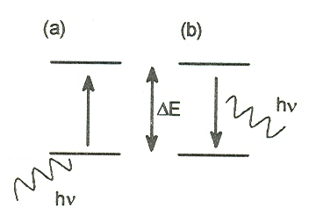
Absorption and Emission
Absorption: When atoms absorb energy, through heating, from electricity, or by absorbing electromagnetic radiation, the electrons of ground level is pushed up to higher levels
Emission: Emission occurs when the excited electron returns to a lower electron orbital. The emitted radiation is termed luminescence. Luminescence is observed at energies that are equal to or less than the energy corresponding to the absorbed radiation.
Absorption
Emission

Slide 44
Electronic transitions
Following types of electronic transition takes place
б б* Transitions
n б* Transitions
n π* transitions
π π* transitions

Slide 45
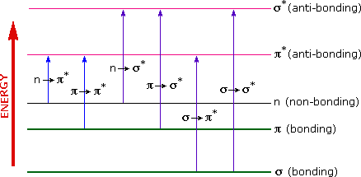
Electronic transitions

Slide 46
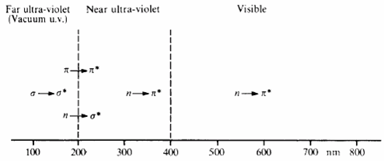
Electronic transitions

Slide 47
Electronic transitions
б → б* Transitions Transitions in which as bonding electron is excited to an antibonding б* orbital are called б → б* transitions. These transitions are shown by only saturated hydrocarbons.
For example, methane (which has only C-H bonds, and can only undergo б → б* transitions) shows an absorbance maximum at 125 nm. Absorption maxima due to б → б* transitions
These wavelengths are lesser than 200 nm and fall in the vacuum UV region.

Slide 48
Electronic transitions
n → б* Transitions: Saturated compounds containing atoms with lone pairs (non-bonding electrons) are capable of n → б* transitions.
These transitions usually need less energy than б → б* transitions.
They can be initiated by light whose wavelength is in the range 150 - 250 nm.
The number of organic functional groups with n → б* peaks in the UV region is small.
e.g., CH₃Cl.

Slide 49
Electronic transitions
n → π* transitions: These are the transitions in which an electron in a non – bonding atomic orbital is promoted to an antibonding π* orbital.
Compounds having double bonds between heteroatoms, e.g., C=O, C=S, and N=O.
For the >C=O group of saturated aldehydes or ketones exhibit an absorption of low intensity at about 285 nm.
These transitions require only small amounts of energy and takes place with in the range of ordinary UV spectrophotometer.
These are generally forbidden transitions.

Slide 50
Electronic transitions
Forbidden transitions
For n → π* transition of a saturated aldehydes or ketones exhibit a weak absorption of low intensity near about 285 nm and having ε_{max} less than 100 is a forbidden transition.
The term molar extinction coefficient (ε_{max}) is a measure of how strongly a chemical species or substance absorbs light at a particular wavelength.

Slide 51
Electronic transitions
π → π* transitions: These are the transitions in which an electron in a p electron is promoted to an antibonding π* orbital.
These transitions require relatively higher amount of energy than n → π* transitions.
For the >C=O group of saturated aldehydes or ketones exhibit an absorption of high intensity at about 180 nm.

Slide 52
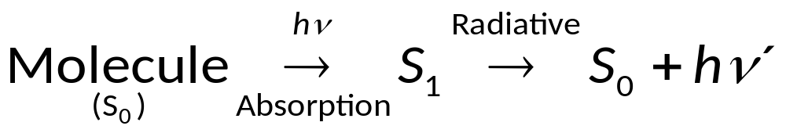
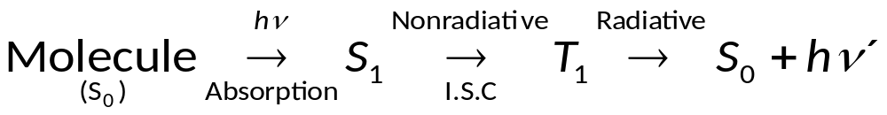
Effect of excited molecules
  The excited molecules can lose their energy in two ways:
    By nonradiative transition
      IC, internal conversion
      ISC, intersystem conversion
    By radiative transition
      Fluorescence
      Phosphorescence

Slide 53
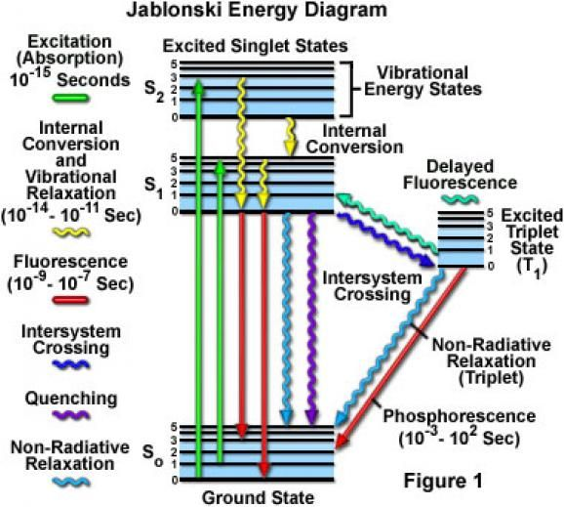
Effect of excited molecules

Slide 54
Photophysical processes
If the absorbed radiation is not used to cause a chemical change, it is re-emitted as light of longer wavelength. The there several photophysical processes occur. For example:
(a) Fluorescence (b) Phosphorescence (c) Chemiluminescence

Slide 55
Fluorescence
Fluorescence is the emission of light by a substance that has absorbed electromagnetic radiation.
According to Stoke’s law, during fluorescence light is absorbed at a certain wavelength and should be emitted at a greater wavelength.
It is a form of luminescence.
The substance that exhibits fluorescence is called florescent substance.
In most cases, the emitted light has a longer wavelength, and lower energy, than the absorbed radiation.
When a beam of light is incident on certain substances, they emit visible light or radiations and they stop emitting light or radiation as soon as the incident light is cut off.
This phenomenon is known as fluorescence.

Slide 56
Fluorescence
Substances which emit radiations during the action of stimulating light are called fluorescent substances.
Examples of fluorescent substance
Chlorophyll present in green leaves show the phenomenon of fluorescence.
Petroleum, vapors of iodine, acetone and hydrocarbons (paraffin and olefins) have been found to fluoresce in ultraviolet regions.

Slide 57
Examples of fluorescent substance
Fluorescence is generally observed in those organic molecules which have rigid framework and not many loosely coupled substituents through which vibronic energy can flow out.
A functional group which exhibits absorption of radiations in the visible or ultraviolet region is called a chromophore.
In analogy with chromophores, following structures are termed as fluorophores.
-C=C-, N=O, -N=N, -C=O, -C=N, -C=S

Slide 58
Examples of fluorescent substance
A large number of substances enhance fluorescence, these are known as fluorochromes in the same analogy as auxochromes.
Generally electron donors group (-OH, -NH₂, -CH₃ etc.) act as auxochromes.
Electron withdrawing group (–COOH, -NO₂) tend to diminish or inhibit fluorescence completely.
For example benzoic acid is non-fluorescent whereas aniline, azophenanthrene are fluorescent

Slide 59
Mechanism of Fluorescence
Fluorescence occurs when an excited molecule, atom, or nanostructure, relaxes to a lower energy state (possibly the ground state) through emission of a photon.
It may have been directly excited from the ground state S₀ to a singlet state, S₁, from the ground state by absorption of a photon of energy (hv_{ex}) and subsequently emits a photon of a lower energy hv_{em} as it relaxes to state S₀:
Excitation: S_{o} + hν_{ex} → S_{n}

Slide 60
Mechanism of Fluorescence
Fluorescence: S₁ → S_{o} + hν_{em}
The singlet state, S₁, lose its remaining energy through further fluorescent emission and/or non-radiative relaxation in which the energy is dissipated as heat.
When the excited state is a metastable state, then that fluorescent transition is rather termed phosphorescence.
Relaxation from an excited state can also occur through transferring some or all of its energy to a second molecule through an interaction known as fluorescence quenching.

Slide 61
Characteristics of Fluorescence
This phenomenon is instantaneous and starts immediately after the absorption of light and stops as soon as the incident light is cut off.
Fluorescence is stimulated by light of the visible or ultraviolet regions of the spectrum.
Substances exhibiting fluorescence generally re-emit excess radiation within 10⁻⁶ to 10⁻⁴ seconds of absorption.
It is a general phenomenon and is exhibited by gases, liquids and solids. No fluoresces will be observed in gases, unless the pressure is low.

Slide 62
Characteristics of Fluorescence
Different substances fluoresce with light of different wavelengths. Thus fluorspar fluoresces with blue light, chlorophyll with red light, uranium glass with green light and so on.
The fluorescent light from solutions is polarized and the degree of polarization depends in some cases upon the concentration of the solution.

Slide 63
Characteristics of Fluorescence
The extent of fluorescence depends upon the nature of the solvent and the presence of certain anions in solution. Thus thiocyanate, iodide and bromide ions show a marked quenching effect.
The quantum efficiency of fluorescence increases in proportional to the wavelength of absorbed radiation. Then after reaching its maximum value in a certain interval of λ_{max}, the efficiency drops rapidly to zero upon a further increase in wavelength.

Slide 64
Applications of Fluorescence
The phenomenon of fluorescence is a well established analytical too. The tool is known as fluorimetry. A large number of application are known. We describe some of them as follows:
1) Fluorescence is used to determine uranium in salts.
2) It is used to determine the ruthenium ion in the presence of other metals.
3) It is used to determine aluminium in alloys.

Slide 65
Applications of Fluorescence
4) It is used to estimate trace of boron in steel.
5) It is used to determine vitamin B₁ and B₂ in food samples.
6) It is used to determine condition of food-stuffs.
7) Ringworm can be detected by this tool.
8) This method has been used in the quantitative analysis of drugs and dyes, textile and paper industry, medicine, fuels and chemicals

Slide 66
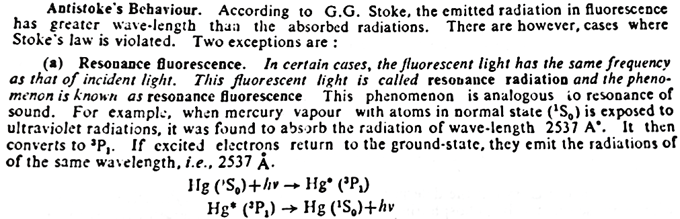
Resonance Fluorescence

Slide 67
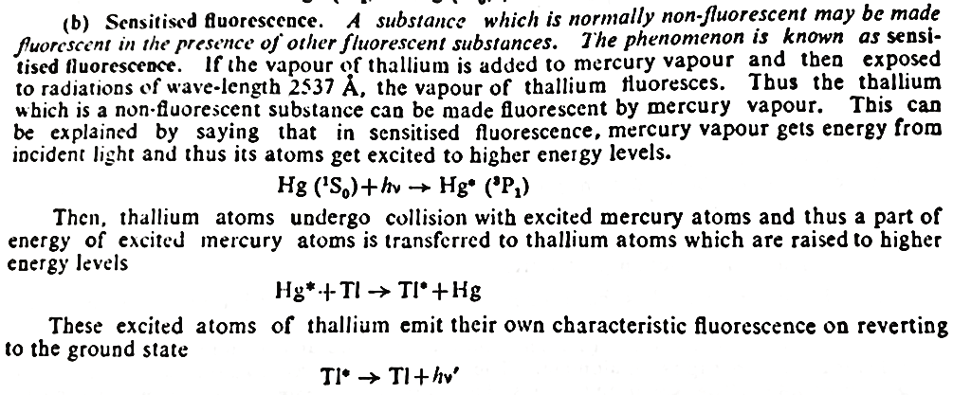
Sensitized Fluorescence

Slide 68
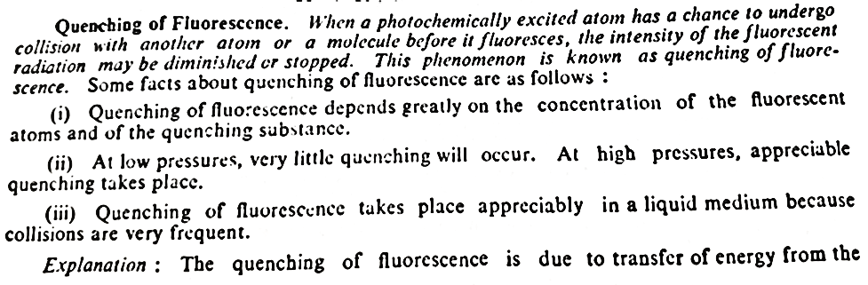
Quenching of Fluorescence

Slide 69
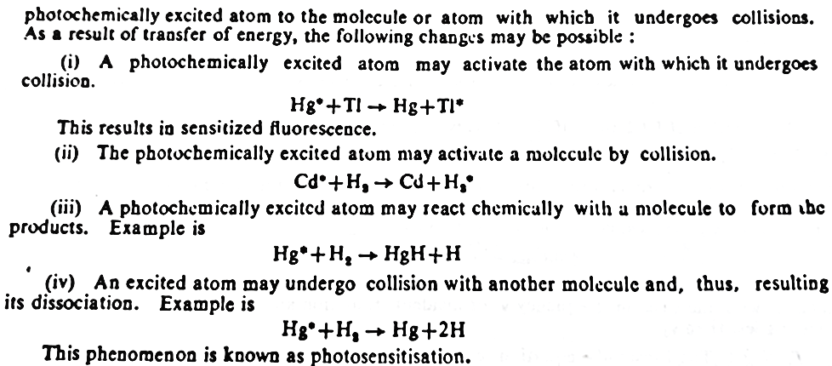
Quenching of Fluorescence

Slide 70
Phosphorescence
When a beam of light is incident on certain substances, they emit light continuously even after the incident light is cut off. This type of delayed fluorescence is called phosphorescence and the substances are called phosphorescent substances.
Characteristics
The life time of phosphorescence (10⁻⁴ to 20 sec) is much longer than fluorescence (10⁻⁶ to 10⁻⁴ sec).
Phosphorescence is mainly caused by ultraviolet and visible light.
It is generally shown by solids.
The magnetic and dielectric properties of phosphorescent substances are different before and after illumination.

Slide 71
Examples of phosphorescent substances
(a) Sulphates of calcium, barium and strontium exhibit phosphorescence.
(b) Many dyes which fluoresce in ordinary light in aqueous solution, it exhibits phosphorescence when dissolved in fused boric acid.
c) Ruby, emerald
d) Certain fungi shows the phosphorescence

Slide 72
Factors Affecting Fluorescence and Phosphorescence
a) All molecules cannot show the phenomena of fluorescence and phosphorescence. Only such molecules show these phenomena that are able to absorb ultraviolet or visible radiation.
B) Substituents often exhibit a marked effect on the fluorescence and phosphorescence molecules.
i) Electron donating group (-OH, -NH₂) often enhance fluorescence.
ii) Electron withdrawing group (–COOH, -NO₂) tend to diminish or inhibit fluorescence completely.
iii) If a high atomic number atom is introduce into a –electron system, it enhances phosphorescence and decrease fluorescence.
c) pH exhibits a marked effect on the fluorescence of compounds.

Slide 73
Applications of Phosphorescence
The phenomenon of phosphorescence is a well established analytical too. The tool is known as phosphorimetry. A large number of application are known. We describe some of them as follows:
1) Phosphorescence is used to determine aspirin in blood serum.
2) It is used to determine cocaine and atropine in urine.
3) It is used to determine procaine, cocaine, phenobarbitol in blood serum.

Slide 74

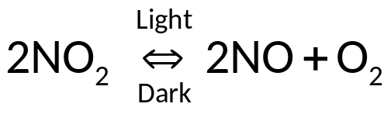
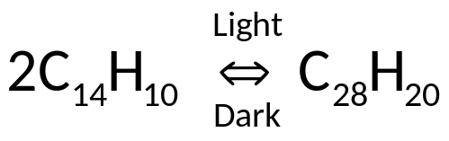
Photochemical Equilibrium
  A state of photochemical equilibrium is said to exist in a reaction when the rates of opposing reactions, of which at least one is light sensitive, become equal under the influence of light radiation.
  Two types:
    First category: only one reaction is light-sensitive
Examples,
      Dissociation of Nitrogen Dioxide:
Dimerisation of Anthracene:

Slide 75

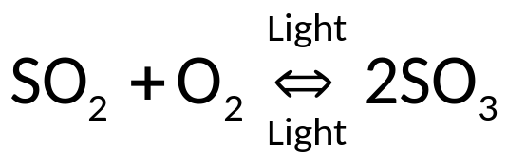
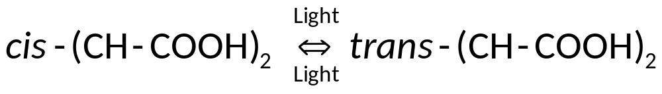
    Second category: both the reactions are light-sensitive
    Examples,
      Formation of Sulphur Trioxide:
      Isomerisation of Maleic acid into Fumaric acid:

Slide 76
Photosensitization
Certain reaction are known which are not sensitive to light.
These reactions can be made light sensitive by adding a small amount of foreign material which can absorb light and stimulate the reaction without itself taking part in the reaction.
Such an added material is known as photosensitizer and the phenomenon as photosensitization.
Photosensitization is different in nature from ordinary catalysis.

Slide 77
Photosensitization
Role played by a photosensitizer
Function of a photosensitizer:
absorb light
become exited
transfer energy to reactants
activate them for reaction without taking part in reaction.
A photosensitizer acts as a carrier of energy.
Examples are:

Slide 78
Photosensitization
Reactions sensitized by Mercury atoms
Dissociation of H₂ into atom at 253.7 nm in the presence of Hg vapour was studied by Carrio and Frank (1922).
Hg(g) + H₂ → 2H +Hg(g) at 253.7 nm
Hg atom absorbs light → Hg* collide with H₂ → dissociate into atoms.
Mechanism:
Hg + hν → Hg*
Hg* + H₂ → H₂* + Hg
H₂* → 2H

Slide 79

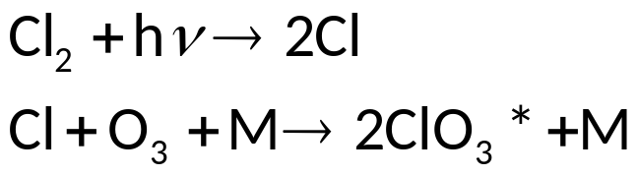
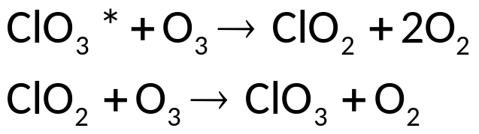
Photosensitization
Chlorine as a photosensitizer
Decomposition of ozone in presence of chlorine in UV.
Rate of reaction independent of concentration but proportional to intensity of light.
Mechanism:
Excited ClO₃* may absorbed on the wall to form Cl₂O₆, Cl₂ and O₂.
ClO₃* may react to form ClO₂ and O₂

Slide 80
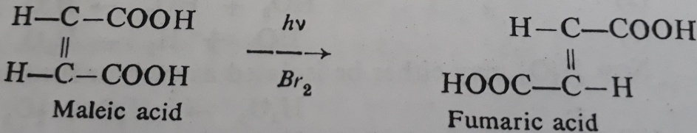
Photosensitization
3. Bromine as a photosensitizer
Bromine acts as a photosensitizer in the conversion of maleic acid into fumaric acid.
4. Cadmium vapour as a photosensitizer
Cadmium vapour acts as a photosensitizer for the polymerisation of ethylene.
nC₂H₄ (-C₂H₂-)_{n}
hν
Cd

Slide 81
Photosensitization
5. Uranyl ion as a photosensitizer
Uranyl ion acts as a photosensitizer in the photolysis of formic acid
UO₂²⁺ + hν → [UO₂²⁺]*
[UO₂²⁺]* + HOOC-COOH → CO₂ + CO + H₂O + UO₂²⁺
6. Chlorophyll as a photosensitizer
Chlorophyll acts as a photosensitizer in the photosynthesis of carbohydrate from CO₂ and H₂O.
Chlorophyll + hν → [Chlorophyll]*
6CO₂ + H₂O + [Chlorophyll]* → C₆H₁₂O₆ + O₂ + Chlorophyll

Slide 82
Photochemical Chain Reactions
Mechanism and kinetics of the following photochemical reactions
Hydrogen-chlorine reaction and
Hydrogen-bromine reaction

Slide 83
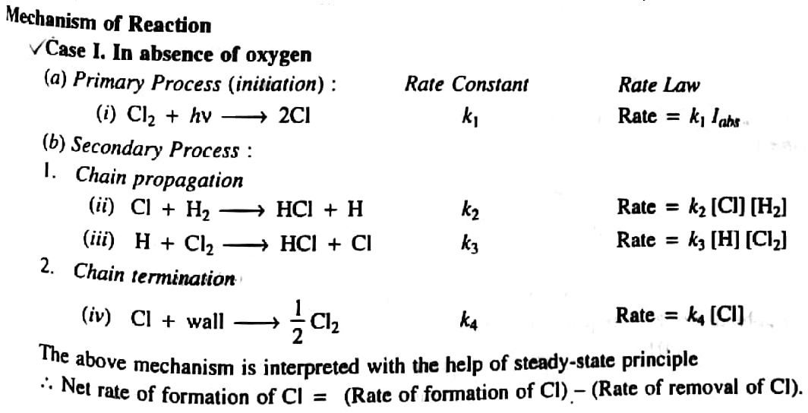
Kinetics of H₂ + Cl₂ Reaction

Slide 84
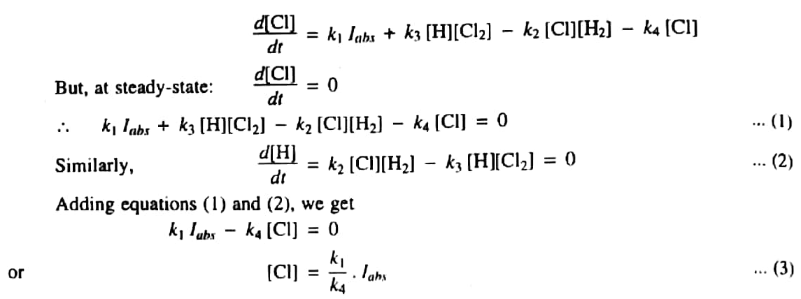
Kinetics of H₂ + Cl₂ Reaction

Slide 85
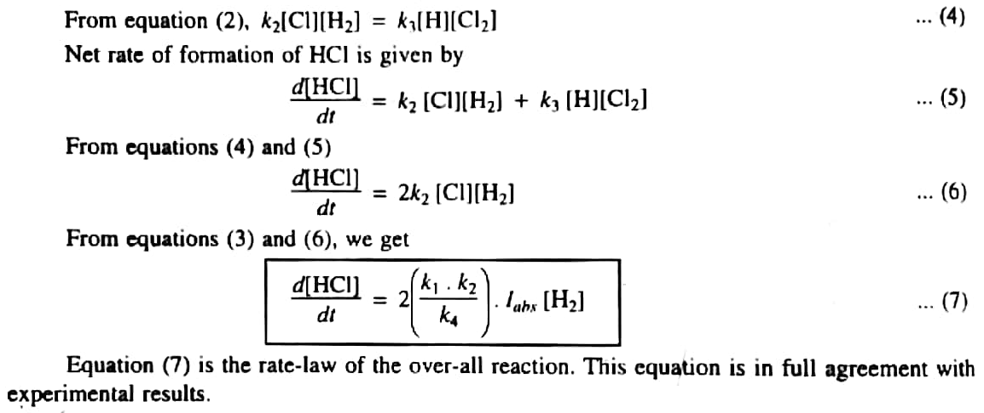
Kinetics of H₂ + Cl₂ Reaction

Slide 86
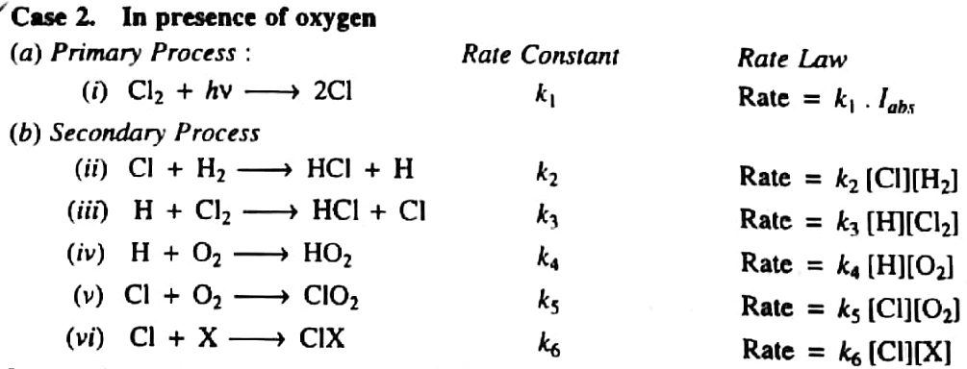
Kinetics of H₂ + Cl₂ Reaction

Slide 87
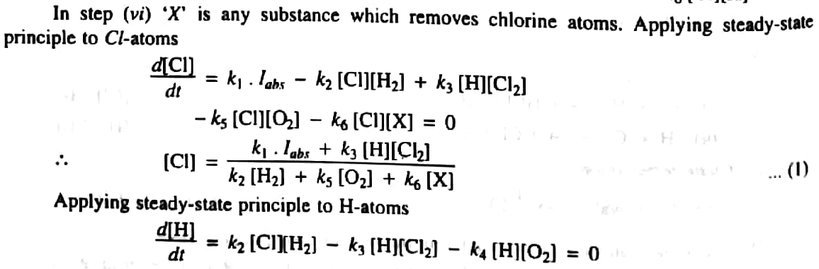
Kinetics of H₂ + Cl₂ Reaction

Slide 88
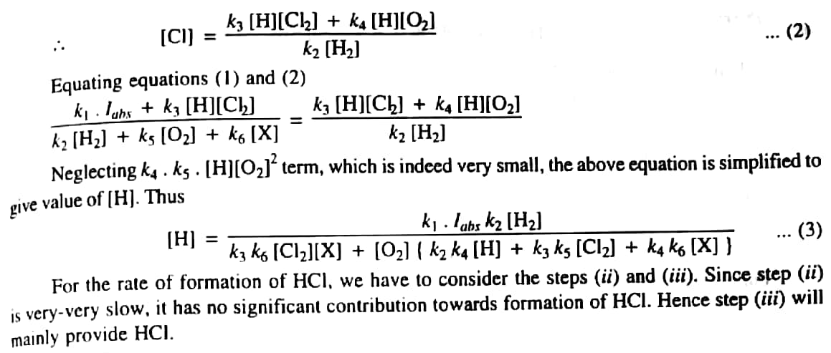
Kinetics of H₂ + Cl₂ Reaction

Slide 89
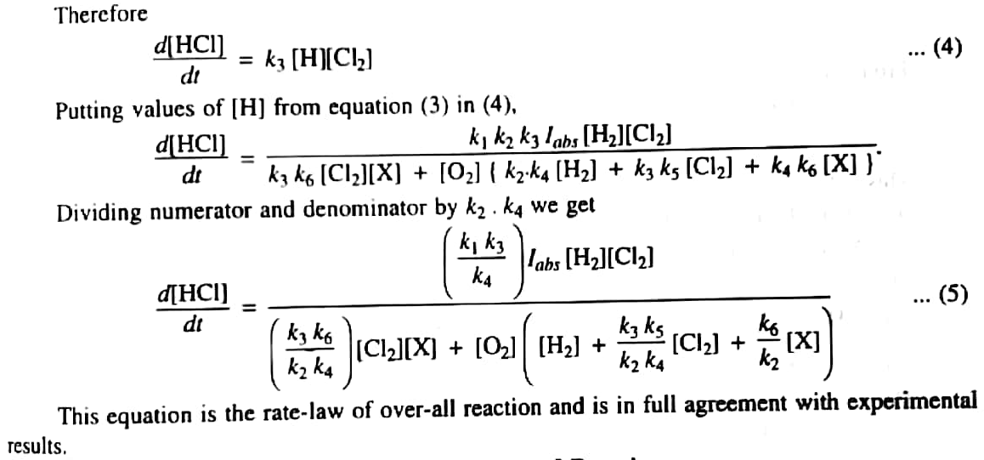
Kinetics of H₂ + Cl₂ Reaction

Slide 90
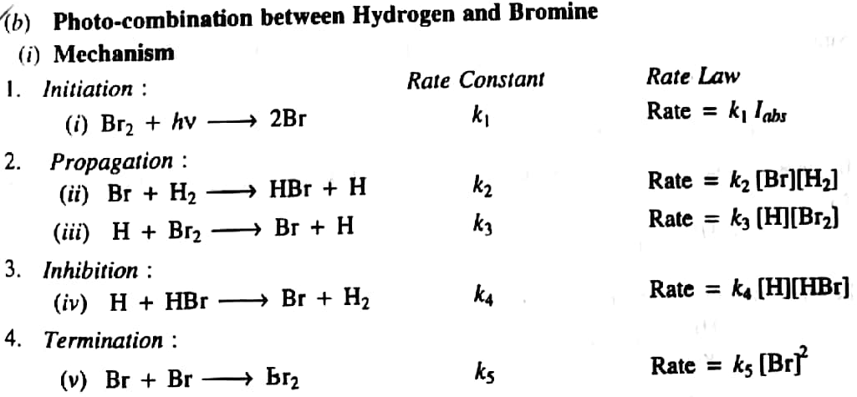
Kinetics of H₂ + Br₂ Reaction

Slide 91
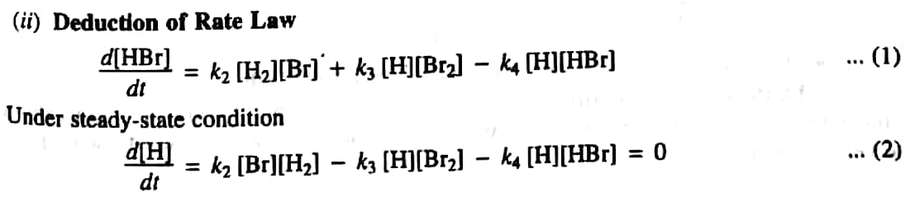
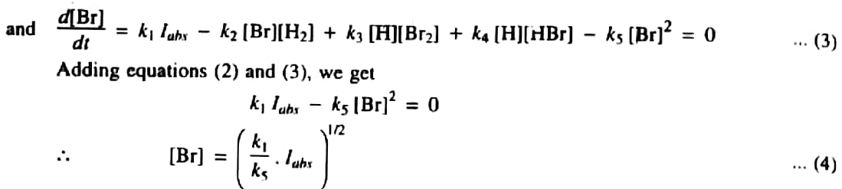
Kinetics of H₂ + Br₂ Reaction

Slide 92
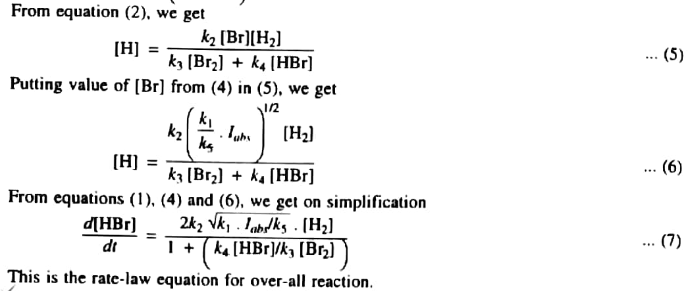
Kinetics of H₂ + Br₂ Reaction

Slide 93
Non-Chain Photochemical Reactions
Dissociation of hydrogen iodide
Photolysis of acetaldehyde

Slide 94
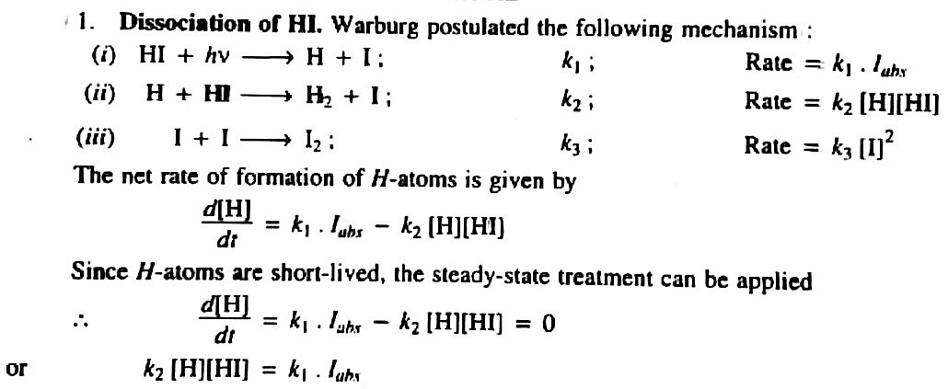
Kinetics of H₂ + I₂ Reaction

Slide 95
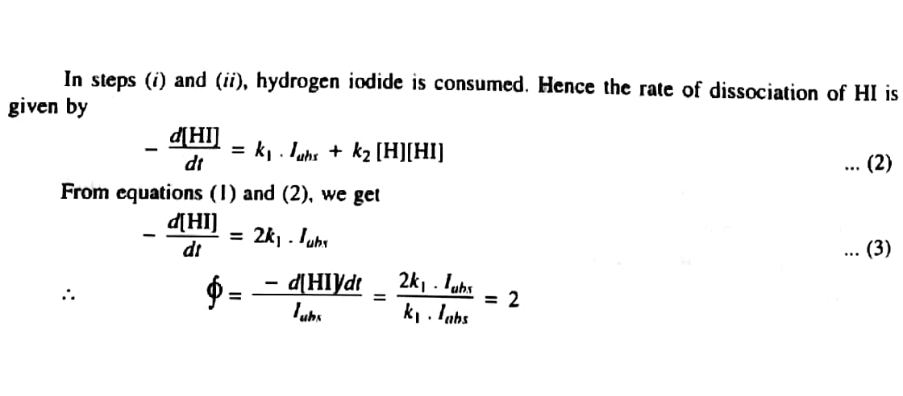
Kinetics of H₂ + I₂ Reaction

Slide 96
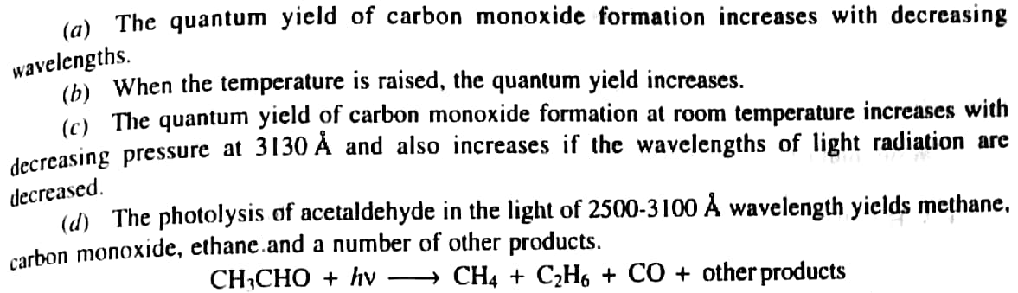
Photolysis of Acetaldehyde

Slide 97
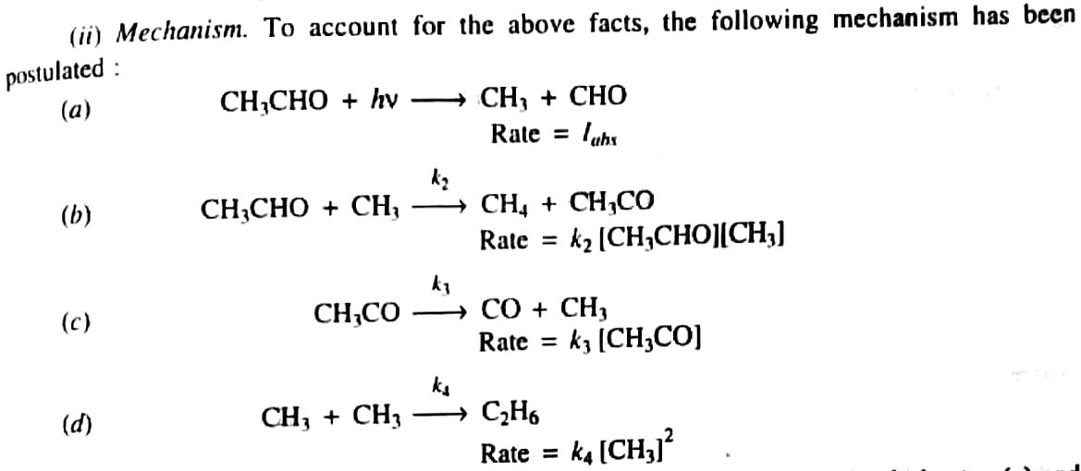
Photolysis of Acetaldehyde

Slide 98
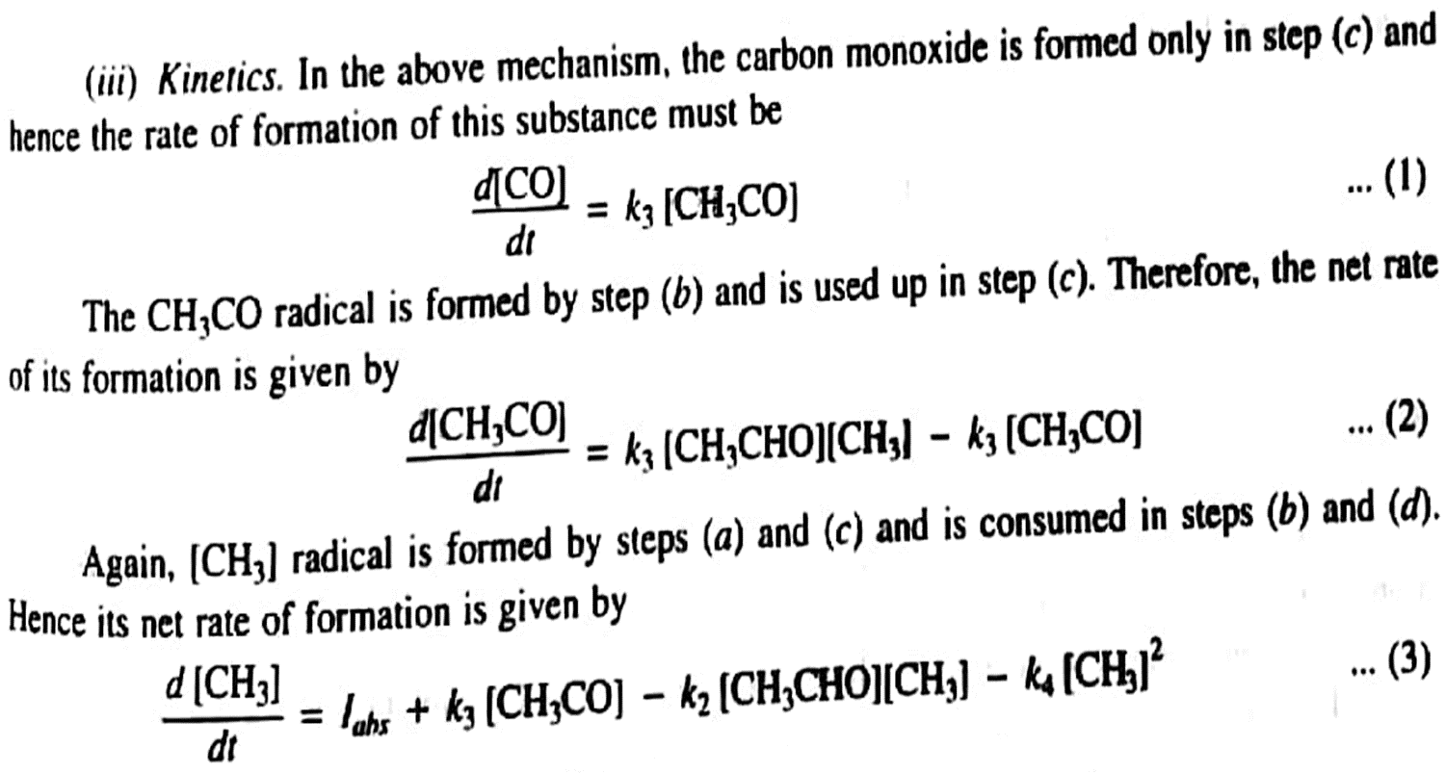
Photolysis of Acetaldehyde

Slide 99
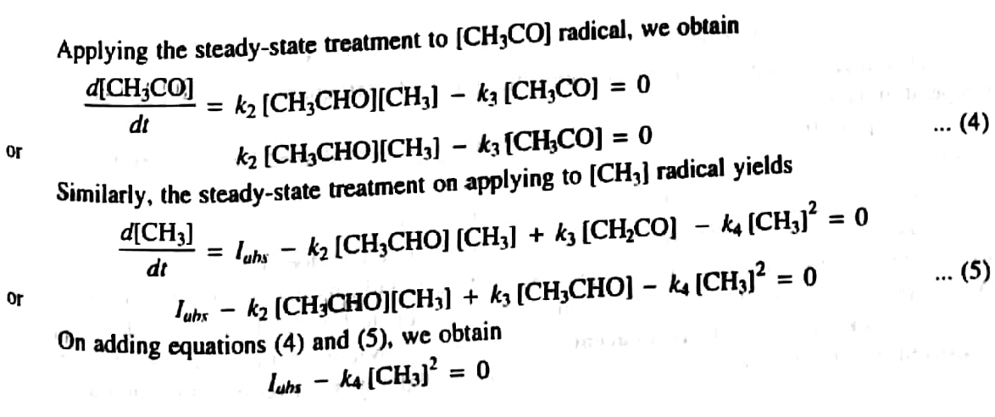
Photolysis of Acetaldehyde

Slide 100
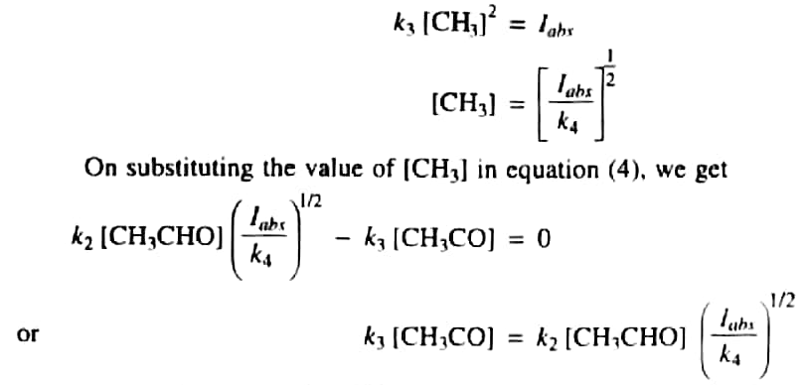
Photolysis of Acetaldehyde

Slide 101
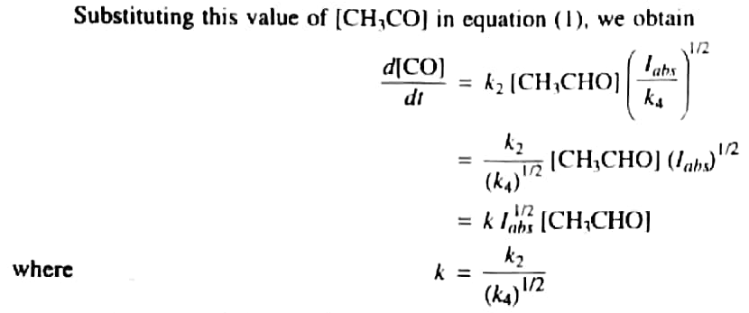
Photolysis of Acetaldehyde

Slide 102
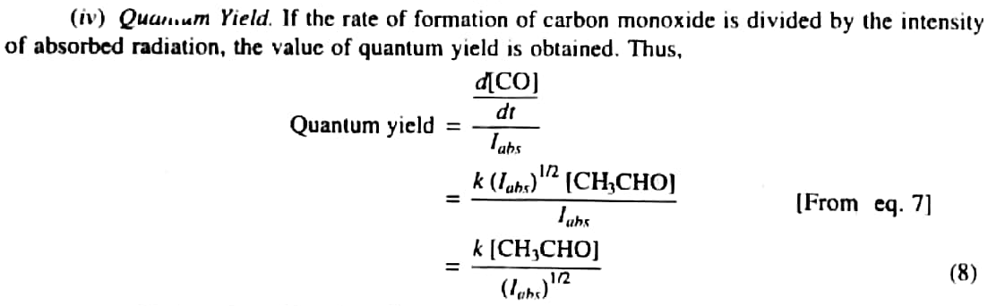
Photolysis of Acetaldehyde

Slide 103
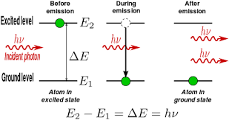
Lasers and its Applications
A laser is a device that emits light (electromagnetic radiation) through a process of optical amplification based on the stimulated emission of photons.
The term "laser" originated as an acronym for light amplification by stimulated emission of radiation.

Slide 104
Lasers and its Applications
Types of lasers
1. Gas lasers
2. Chemical lasers
3. Dye lasers
4. Metal vapour lasers
5. Semiconductor lasers
6. Free electron lasers

Slide 105
Lasers and its Applications
Gas lasers
Laser Type | Applications
Helium-Neon laser | Spectroscopy, barcode scanning, alignment, optical demonstrations.
Argon laser | Retinal phototherapy, lithography
Nitrogen laser | Pumping of dye lasers, measuring air pollution, scientific research.
CO₂ laser | Material processing (welding), photoacoustic spectroscopy

Slide 106
Lasers and its Applications
Chemical lasers
Laser Type | Applications
Hydrogen Fluoride laser | Used in research for laser weaponry by the U.S
Oxygen-iodine laser | Laser weaponry, scientific and materials research
All gas-phase iodine laser | Scientific, weaponry, aerospace.
Dye lasers: Research, laser medicine, spectroscopy, birth mark removal, isotope separation

Slide 107
Lasers and its Applications
Metal-vapour lasers
Laser Type | Applications
He-Cd vapour laser | Printing and type setting applications, fluorescence excitation examination, scientific research
Cu vapour laser | Dermatological uses, high speed photography, pump for dye lasers

Slide 108
Lasers and its Applications
Free electron lasers: Atmospheric research, material science, medical application
Semiconductor lasers: It uses for telecommunication, printing, holography, weapons, machining, welding

Slide 109

Azophenanthrene

